Slide 1
GTT - Final meeting
Mark Rachman & Nir Kravetzky

Slide 2
Agenda
Goal
Progress During The Semester
Final Product
Schema
Problems Encountered & Solutions
Live Demo

Slide 3
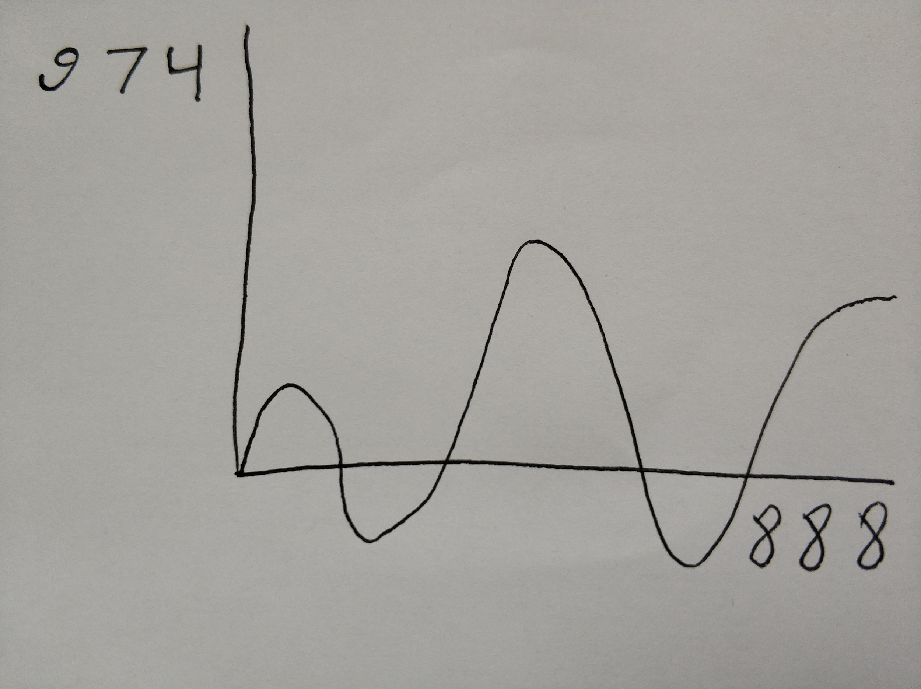
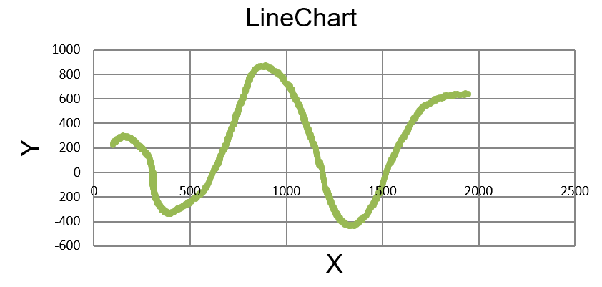
Goal
Turn a handwritten picture of price (or volume)
into a stream of market data (table format)

Slide 4
Progress During The Semester
Kick-Off Meeting
Image in a given format (png)
Recognize graph axis
Recognize graph line
Calculate exact x,y values for every point of the line
Process output
Timeline for the semester
Week 2 - Kickoff meeting
Week 7 -
Midway Meeting
Week 11
Week 13 -
Final Meeting

Slide 5
Progress During The Semester
Mid-Way Meeting
Yellow - New
Green - Done
Red - In Progress
Image in a given format (png + jpg)
Recognize graph axis
Recognize graph line
Detect numbers
Calc x,y values for every point of the line
Process output
Timeline for the semester
Week 2 - Kickoff meeting
Week 7 -
Midway Meeting
Week 11
Week 13 -
Final Meeting

Slide 6
Progress During The Semester
Final Meeting
Image in a given format (png / jpg)
Recognize graph axis
Recognize graph line
Detect numbers
Calc x,y values for every point of the line
Process output
Timeline for the semester
Week 2 - Kickoff meeting
Week 7 -
Midway Meeting
Week 11
Week 13 -
Final Meeting

Slide 7
Final Product
GTT is built in Python.
We used some known visual recognition
algorithms for reading the image (using OpenCV).
We used deep learning classifier in order.
to recognize digits better (KERAS + TF).
We created independent modules that communicates
between themselves (through an integrator).

Slide 8
Schema
GTT
GTT_numbersDetection
main
GTT_graphDetection
pic2data
GTT_stripes
exportXY
GTT_output

Slide 9
Problems Encountered & Solutions
Axes Detection
X - axis detection
We assume that the longest vertical line is
the x axis.
Y - axis detection
We divide the image into small horizontal stripes.
Each point has an epsilon radius. All the points in this epsilon radius will be removed.
We choose the stripe with the biggest number of points after the filter.
Origin point
Is the intersection between x and y axis.

Slide 10
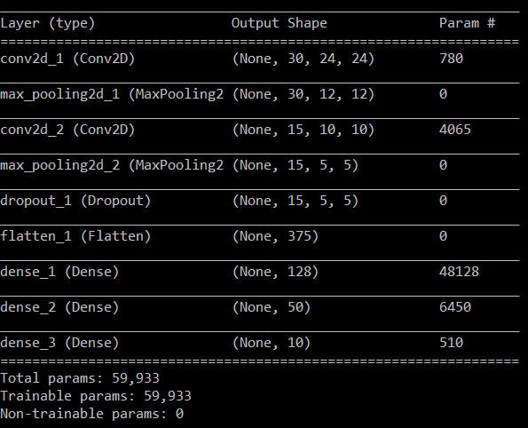
Problems Encountered & Solutions
Digit Recognition
In order to recognize handwritten digits, we
trained a classifier with TF.

Slide 11
Problems Encountered & Solutions
Graph Detection
In order to recognize the graph we perform the following steps:
Convert image to gray colors.
Run gaussian blur function.
Perform canny edge detection algorithm.
Use Hough lines transformation.
Remove the detected axes.
Remove the digits.

Slide 12
Live demo
Notes:
python GTT.py --source=graphs\insane.jpg
python GTT.py --source=graphs\insane.jpg --log_level=4

